Slide 1
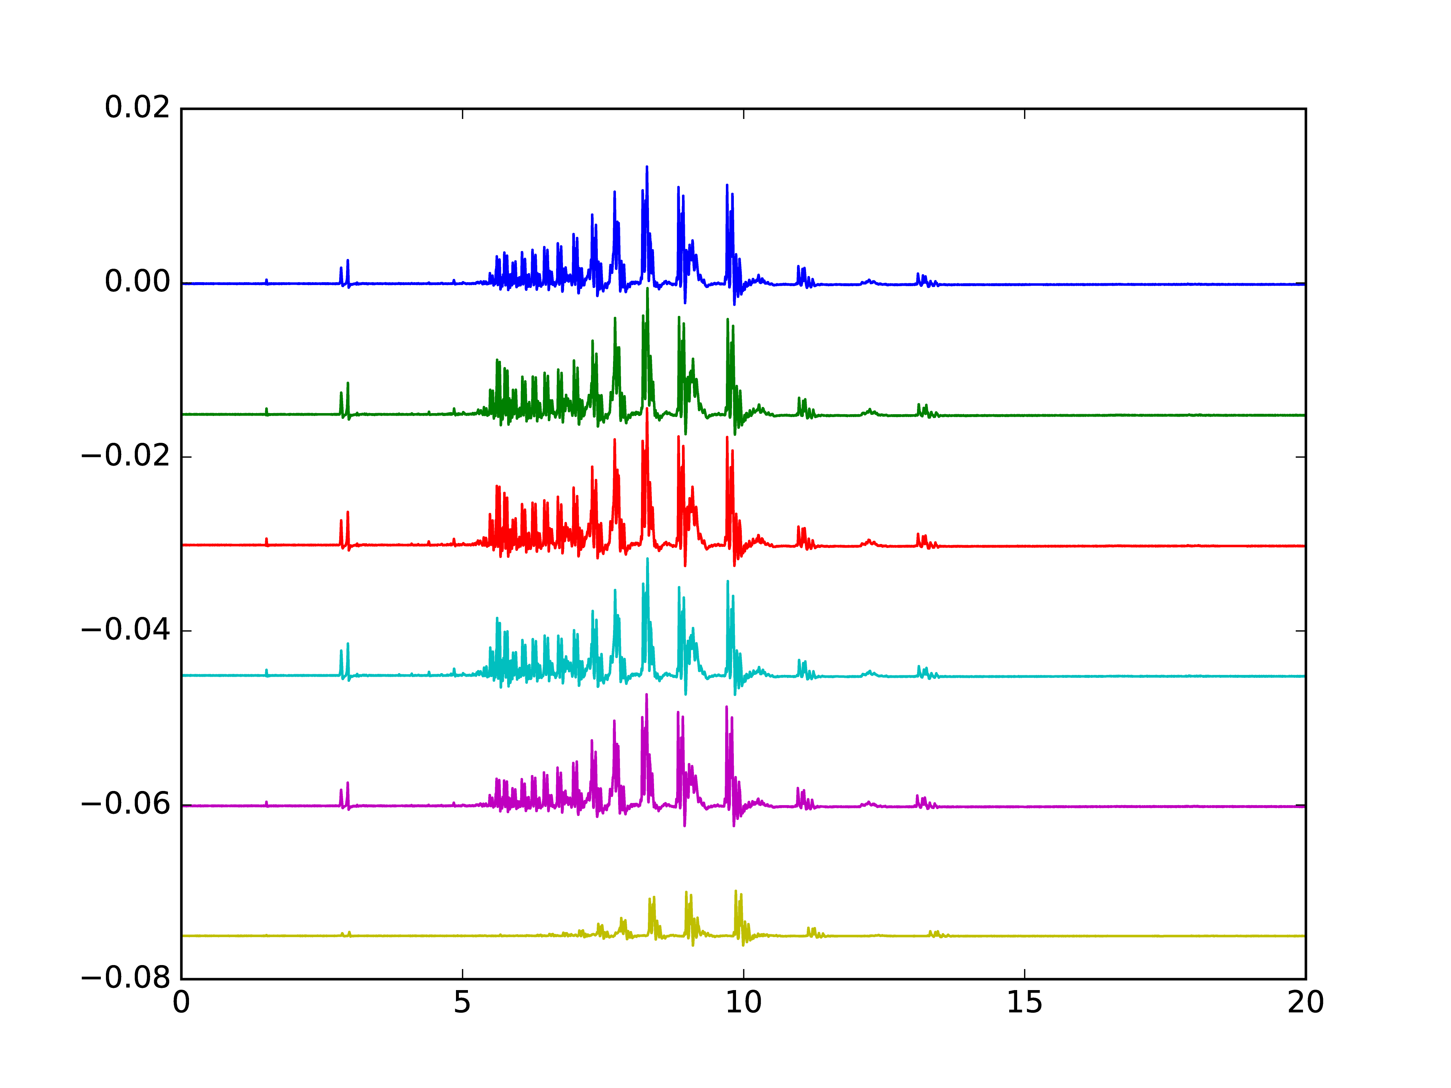
0 fs
120 fs
250 fs
Counts in Volt with offset for each time delay
400 fs
800 fs
Pump only
Time-of-flight in µs

Slide 2
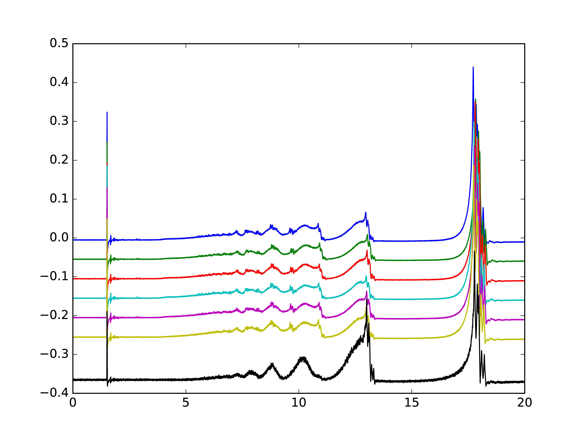
Counts in Volt with offset for each time delay
0 fs
60 fs
120 fs
250 fs
400 fs
800 fs
Pump only
Time-of-flight in µs

Slide 3
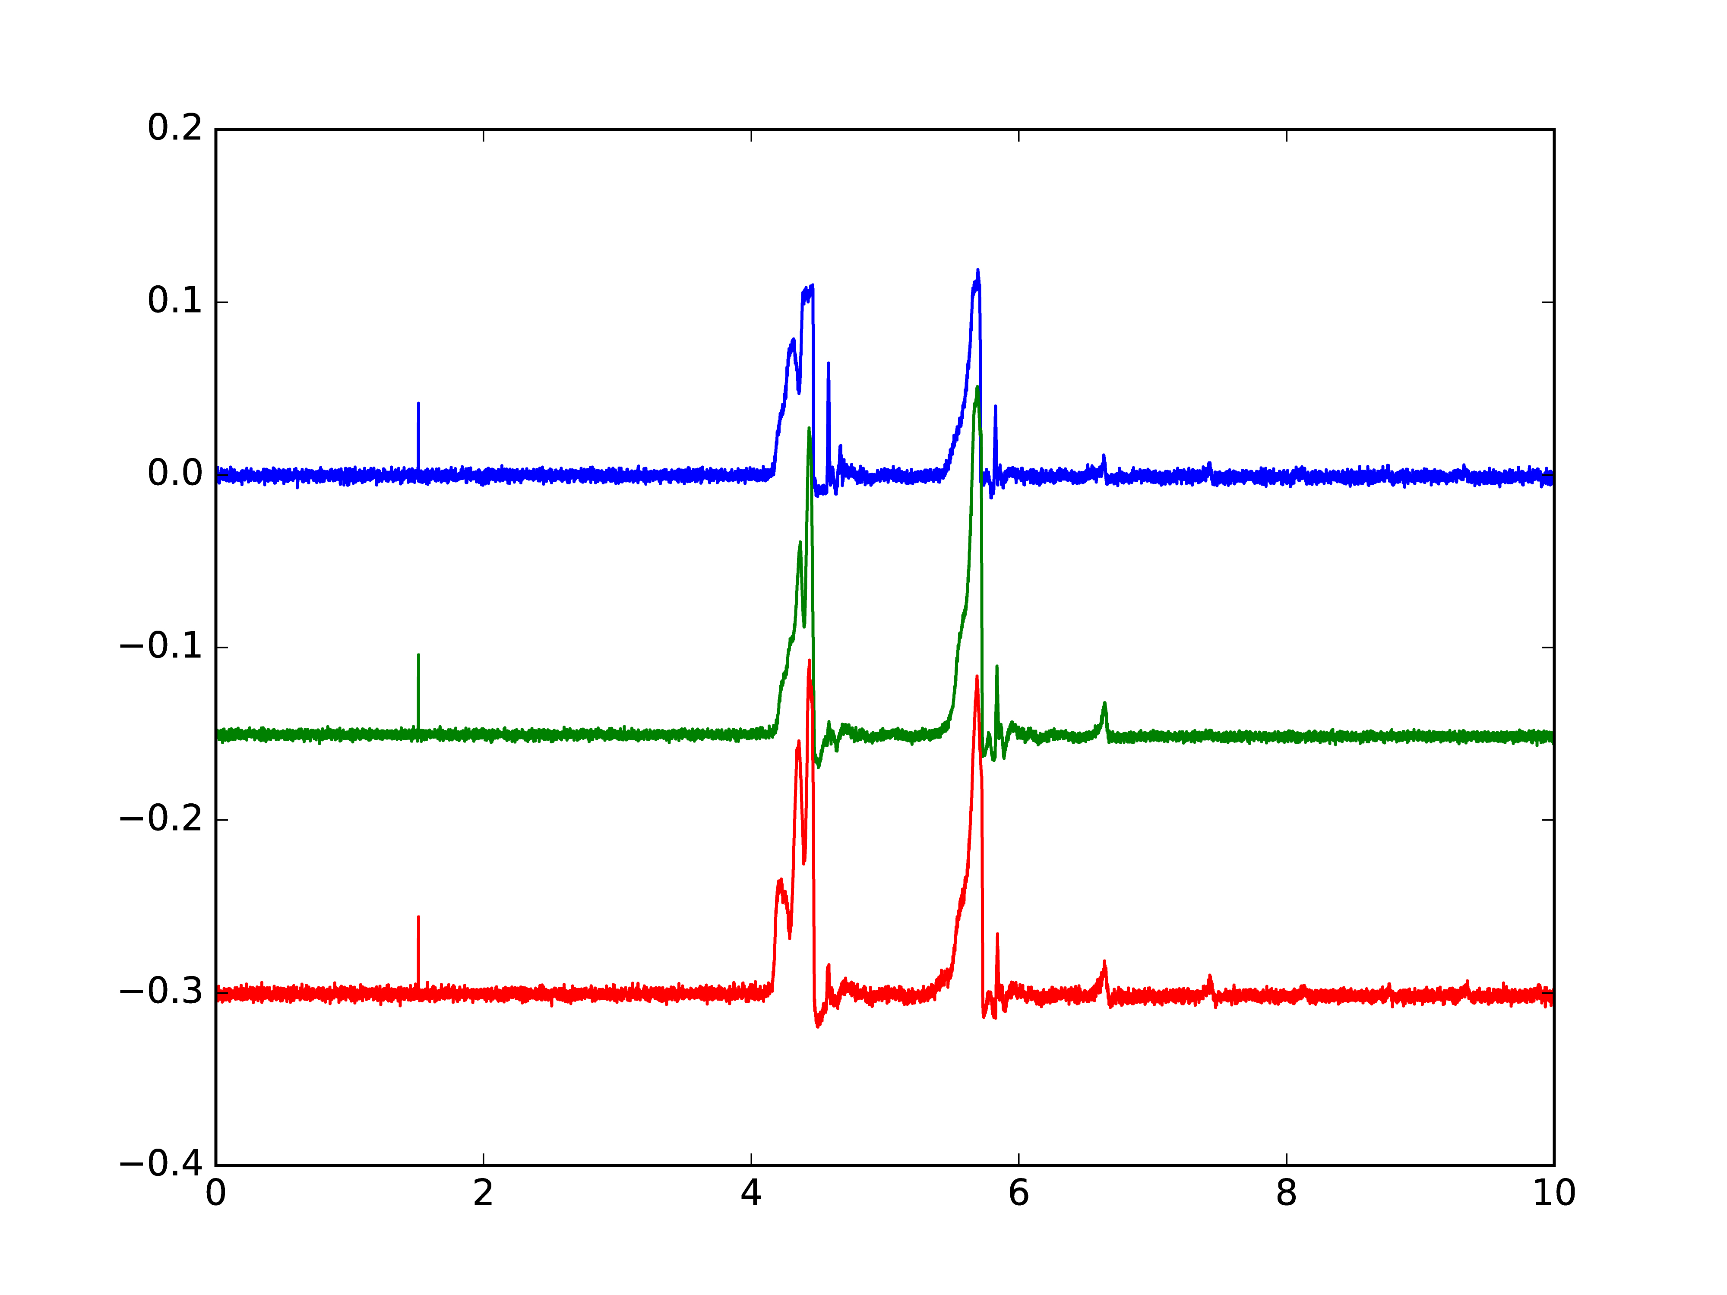
He⁺
He₂⁺
0 fs
Counts in Volt with offset for each time delay
He₃⁺
250 fs
800 fs
Time-of-flight in µs

Slide 4
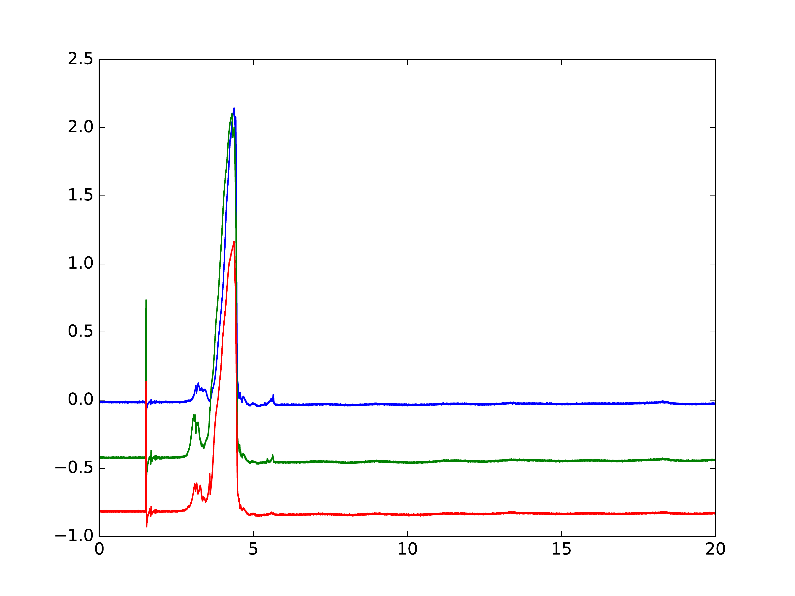
He⁺
Counts in Volt with offset for each time delay
Xe charge fragments
He²⁺
He₂⁺
0 fs
200 fs
800 fs
Time-of-flight in µs

Slide 5
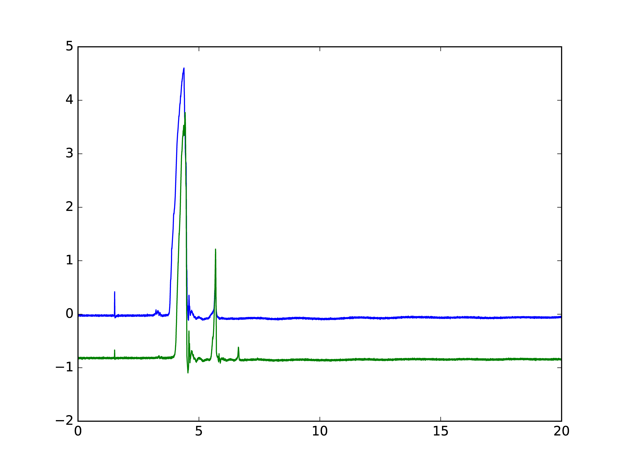
He⁺
Counts in Volt with offset for each time delay
Xe charge fragments
He₂⁺
He²⁺
0 fs
He₃⁺
800 fs
Time-of-flight in µs

